Slide 1
Responsive layout with flexbox
Yoni Mishani
mishaniy@gmail.com
January 2017

Slide 2
No longer like that

Slide 3
The need’s explanation
A brief explanation of the history of HTML.
HTML layout not as designed from the first place.
HTML workarounds to design what we planned.

Slide 4
Units of measurement
% - relative to parent
em – relative to parent font size
rem – relative to root font size
vw – relative to viewport width
vh – relative to viewport height

Slide 5
Units of Measurement
Relative units of measurements are your best guess at the ideal, but they are still a guess.

Slide 6
Background
The Flexbox Layout (Flexible Box) exists since 2009.
Flexbox is providing a more efficient way to layout, align and distribute space among items in a container, even when their size is unknown and/or dynamic.
The main idea behind the flex layout is to give the container the ability to alter its items width, height and order to best fill the available space (mostly to accommodate to all kind of display devices and screen sizes). A flex container expands items to fill available free space, or shrinks them to prevent overflow.

Slide 7
FLEXBOX
WHY NOW?

Slide 8
Syntax 2009
.container {
display: -webkit-box; /* Safari 3 to 7, Chrome 4 to 20, Android Browser */
display: -moz-box; /* Firefox 2 to 21 */
-webkit-box-direction: normal;
-moz-box-direction: normal;
-webkit-box-orient: horizontal;
-moz-box-orient: horizontal;
-webkit-box-align: start;
-moz-box-align: start;
}

Slide 9
Syntax 2011
.container {
display: -ms-flexbox; /* IE 10 */
-ms-flex-flow: row;
-ms-flex-align: start;
}

Slide 10
Syntax 2012
.container {
display: flex; /* since Chrome 29, Firefox 22, Safari 9 and IE11 */
display: -webkit-flex; /* Safari 7 to 8 and Chrome Android 4.4 */
flex-direction: row;
-webkit-flex-direction: row;
align-items: flex-start;
-webkit-align-items: flex-start;
}

Slide 11

.container {
display: -webkit-box; /* Safari 3 to 7, Chrome 4 to 20, Android Browser */
display: -moz-box; /* Firefox 2 to 21 */
display: -ms-flexbox; /* IE 10 */
display: -webkit-flex; /* Safari 7 to 8 and Chrome Android 4.4 */
display: flex; /* since Chrome 29, Firefox 22, Safari 9 and IE11 */
-webkit-box-direction: normal;
-moz-box-direction: normal;
-webkit-box-orient: horizontal;
-moz-box-orient: horizontal;
-ms-flex-flow: row;
-webkit-flex-direction: row;
flex-direction: row;
-webkit-box-align: start;
-moz-box-align: start;
-ms-flex-align: start;
-webkit-align-items: flex-start;
align-items: flex-start;
}

Slide 12
Syntax today
.container {
display: -webkit-flex;
display: flex;
-webkit-flex-direction: row;
flex-direction: row;
-webkit-align-items: flex-start;
align-items: flex-start;
}

Slide 13
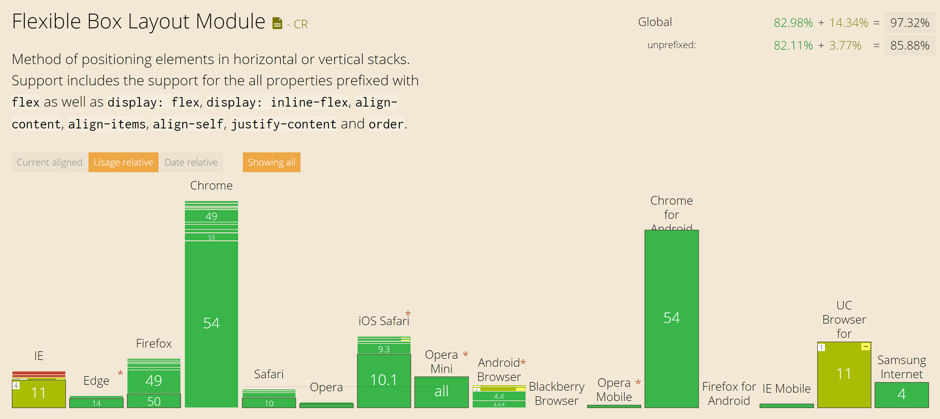
Browser support
UC Android support with -webkit prefix
Global usage
IE 10 0.25%
IE 11 3.69%
Old Android support with -webkit prefix

Slide 14
Drop support IE 8,9,10
Microsoft announced on January 12, 2016, Effective that date, only the most recent version of Internet Explorer available for a supported operating system will receive technical support and security updates.
Support for Internet Explorer 8 will be dropped completely for Windows desktop and server.

Slide 15
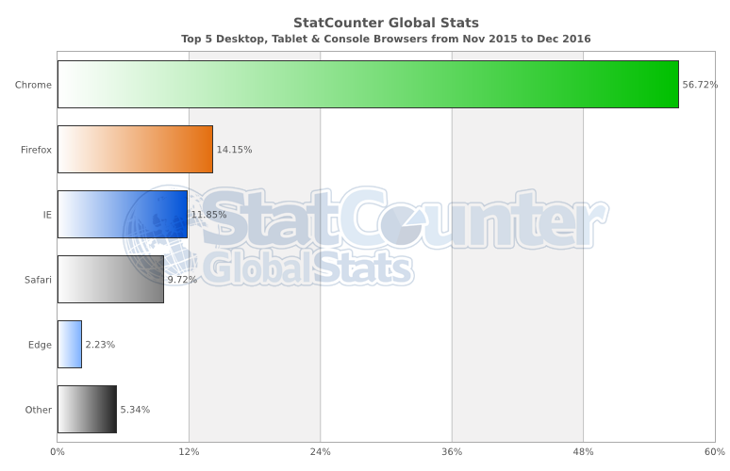
Browser usage table

Slide 16
css

Slide 17
Display flex
<div class="container">
<div class="item"></div>
<div class="item"></div>
<div class="item"></div>
</div>
.container{
display: flex;
flex-direction: row; /* default */
}

Slide 18
Flex property
.container{
display: flex;
}
.item{
flex: 1;
}
.item:nth-child(2){
flex: 2;
}

Slide 19
Flex property definition
Flex property consists of three parameters.
Flex
flex-grow
This defines the ability for a flex item to grow if necessary.
Proportion of extra space that it gets.
flex-shrink
This defines the ability for a flex item to shrink if necessary.
Proportion of overflow that gets shaved off.
flex-basis
This defines the default size of an element before the remaining space is distributed.
Any standard width/height value including auto

Slide 20
flex-direction property
.container{
display: flex;
flex-direction: column;
}
.item{
flex: 1;
}

Slide 21
order property
.container{
display: flex;
}
.item:nth-child(1){
order: 3;
}
.item:nth-child(3){
order: 2;
}

Slide 22
Justify-content property
center
.container{
display: flex;
justify-content: center;
}
.item{
flex: 0 0 5em;
}

Slide 23
Justify-content property
space-around
.container{
display: flex;
justify-content: space-around;
}
.item{
flex: 0 0 5em;
}

Slide 24
align-items property
flex-start
.container{
display: flex;
align-items: flex-start;
}
.item{
flex: 1;
}

Slide 25
Align-items property
center
.container{
display: flex;
align-items: center;
}
.item{
flex: 1;
}

Slide 26
Align-self property
.container{
display: flex;
align-items: flex-end;
}
.item:nth-child(2){
align-self: stretch;
}

Slide 27
Flex property + margin
.container{
display: flex;
}
.item {
flex: 0 0 5em;
}
.item:nth-child(2){
margin: 10px auto;
}

Slide 28
Flex-wrap property
.container{
display: flex;
flex-wrap: wrap ;
}
.item {
flex: 0 0 10em;
}

Slide 29
Live Coding

Slide 30
Summary
Flexbox can help make your site more responsive.
Flexbox requires a change in mindset.
It’s OK to use media queries and other measurement units.
Flexbox isn’t all or nothing.

Slide 31
Thanks!
Yoni Mishani
mishaniy@gmail.com
github: mishaniy/flexbox

